Slide 1

«Lo sviluppo internazionale del Polo MERCITALIA»
Notes:
Serfer al centro
Change the image:
Right Click on Image >> Change Picture >> Choose your Image.

Slide 2

RFI
TRENITALIA
POLO MERCITALIA
Ricavi: € 1 Mld Dipendenti: 5.000 Persone
Notes:
GENERAL INFORMATION
This slide used an animation by means of triggers, see the Help file for more information.
-----------------------------------------------
HOW IT WORKS?
1. Runs the presentation
2. Click on the map marker (on the map) to display a textbox additional
3. Click again to hide it.

Slide 3
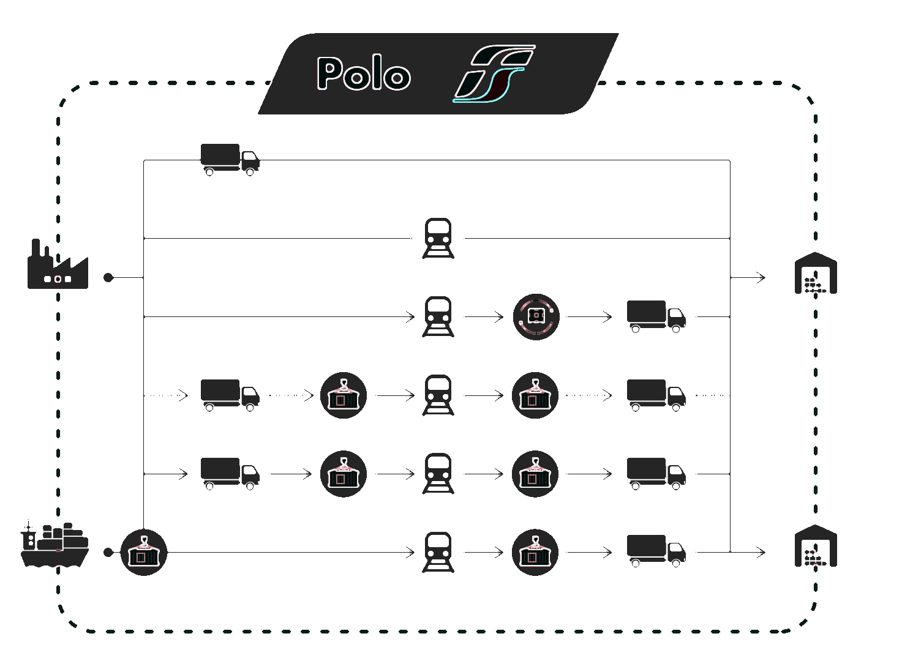
FATTURATO CONSOLIDATO
€ 2,1
Mld
€ 1
Mld
2017
2026
2026
50% QUOTA INTERNAZIONALE
Notes:
GENERAL INFORMATION
This slide used an animation by means of triggers, see the Help file for more information.
-----------------------------------------------
HOW IT WORKS?
1. Runs the presentation
2. Click on the map marker (on the map) to display a textbox additional
3. Click again to hide it.

Slide 4
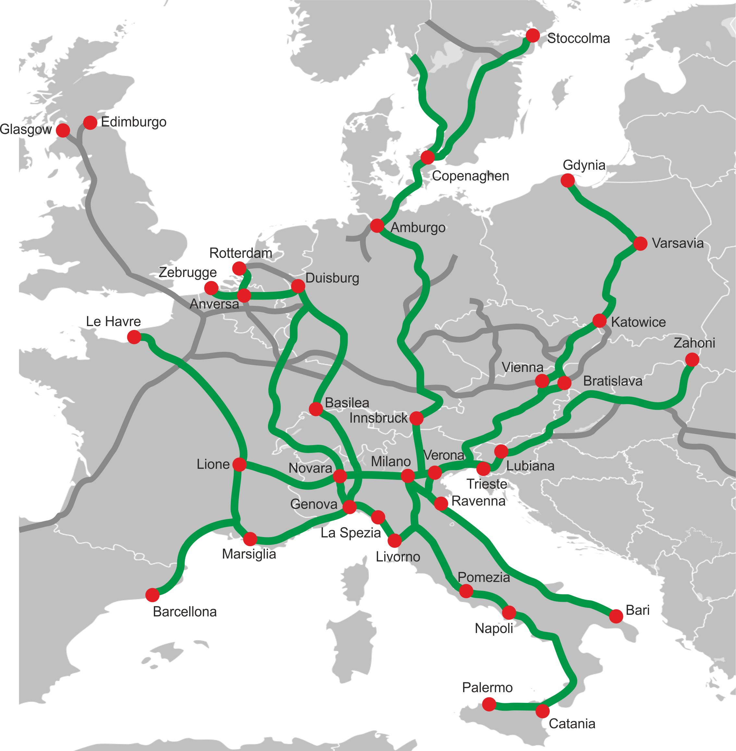
NUOVA STRATEGIA DI SVILUPPO INTERNAZIONALE
RIPROGETTAZIONE DELL’OFFERTA
INTERLOCUTORE UNICO
CONTROLLO DEI FATTORI DELLA PRODUZIONE
Notes:
GENERAL INFORMATION
This slide used an animation by means of triggers, see the Help file for more information.
-----------------------------------------------
HOW IT WORKS?
1. Runs the presentation
2. Click on the map marker (on the map) to display a textbox additional
3. Click again to hide it.

Slide 5
INVESTIMENTI CUMULATI: PIANO 2017-2026
INVESTIMENTI CUMULATI: 1,5 Mld€
1,0 Mld€
0,1 Mld€
0,1 Mld€
0,3 Mld€
LOCOMOTORI
CARRI
TERMINAL
ICT & SICUR.
ACQUISIZIONI
400 Mil€
25 Mil€
20 Mil€
15 Mil€
RISORSE IMPEGNATE NEL 2017: 0,5 Mld€
Notes:
GENERAL INFORMATION
This slide used an animation by means of triggers, see the Help file for more information.
-----------------------------------------------
HOW IT WORKS?
1. Runs the presentation
2. Click on the map marker (on the map) to display a textbox additional
3. Click again to hide it.

Slide 6




SWISS CORRIDOR & POLO MERCITALIA: L’ESEMPIO CP
ANZIO (RM)
CAMION, CARRI
& CONTAINER
TRAZIONE FERROVIARIA
ITALIA
1.600 KM
(96% Rail)
TRAZIONE FERROVIARIA
SVIZZERA - GERMANIA
HANDLING
KOLN (Germany)
Notes:
GENERAL INFORMATION
This slide used an animation by means of triggers, see the Help file for more information.
-----------------------------------------------
HOW IT WORKS?
1. Runs the presentation
2. Click on the map marker (on the map) to display a textbox additional
3. Click again to hide it.

Slide 7
Notes:
Serfer al centro
Change the image:
Right Click on Image >> Change Picture >> Choose your Image.

